Slide 1

INTRODUCTION TO CYBER SECURITY
Dr.Quratulain Alam,
Assistant Professor,
COMSATS UNIVERSITY ISLAMABAD
.

Slide 2
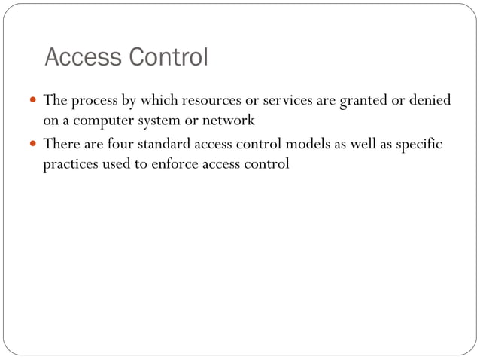

Slide 3
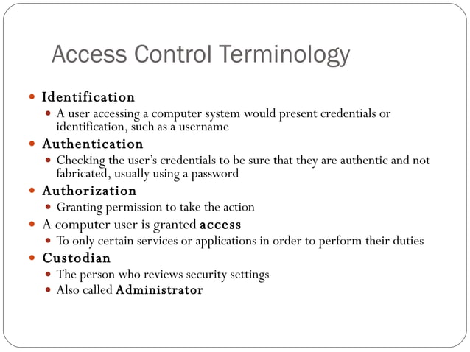

Slide 4
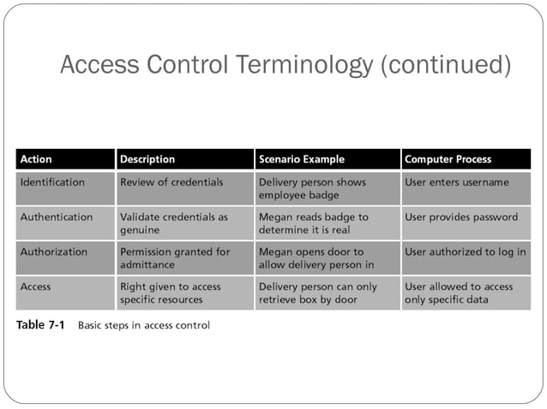

Slide 5
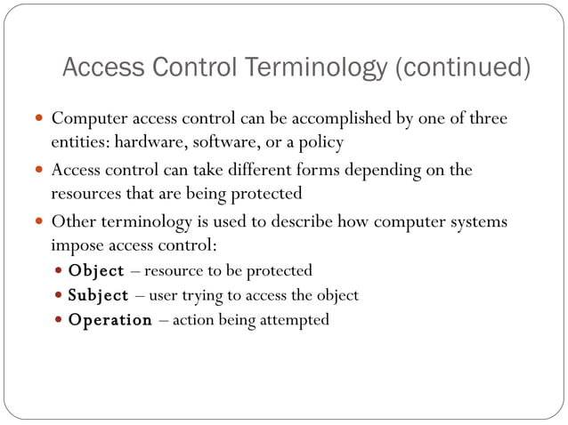

Slide 6
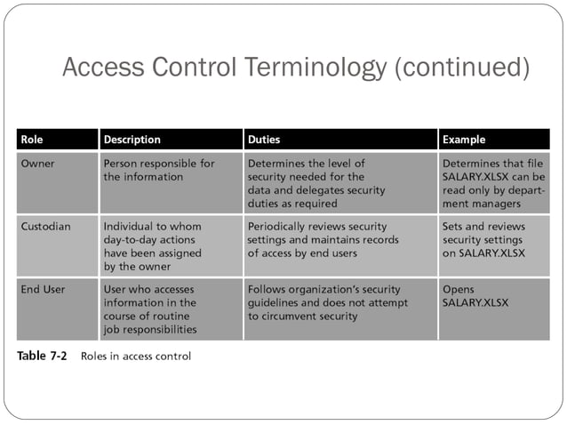

Slide 7
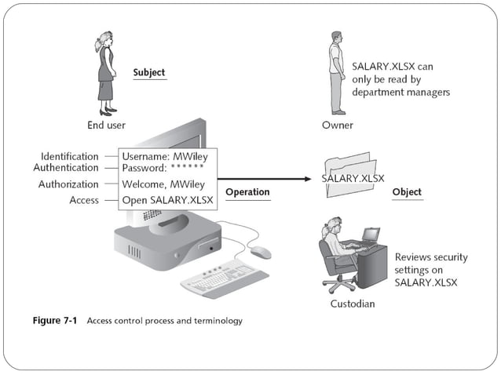

Slide 8
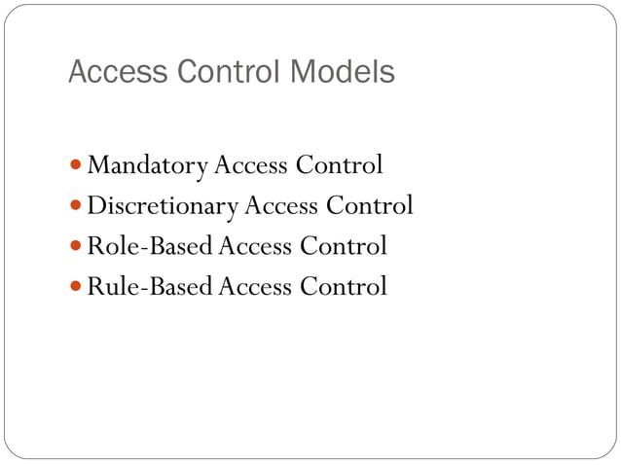

Slide 9
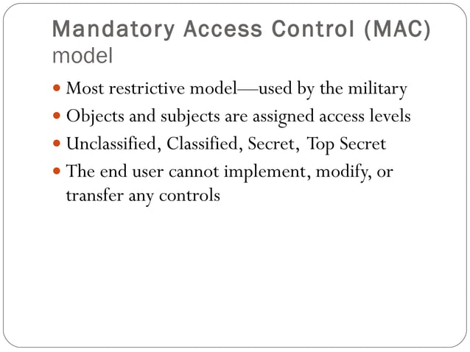

Slide 10
MANDATORY ACCESS CONTROL
Umair Tayyeb
Classified
Secret
Finance
HR
Finance records
Employee records
Classified Secret
Finance
HR

Slide 11
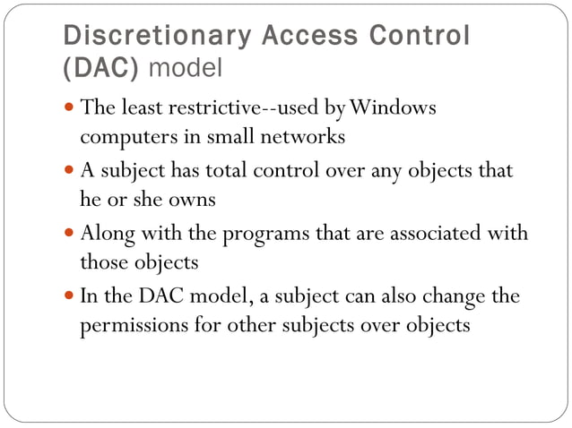

Slide 12
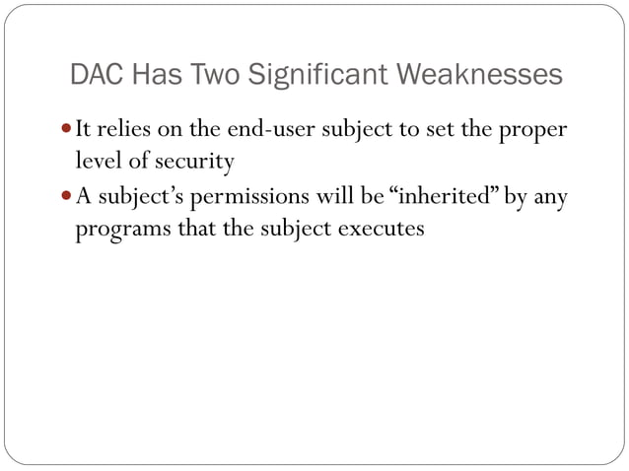

Slide 13
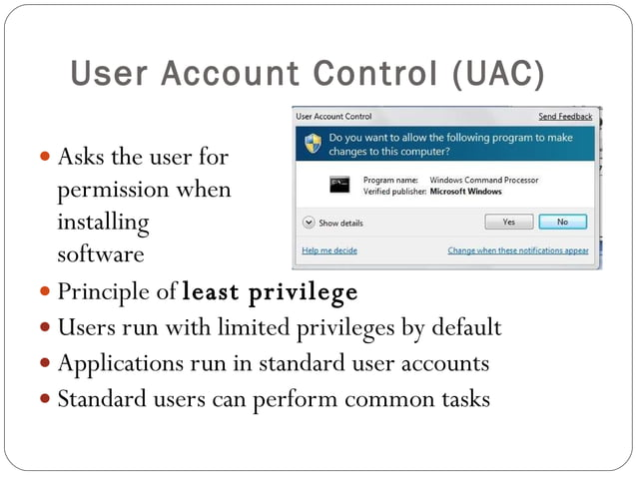

Slide 14
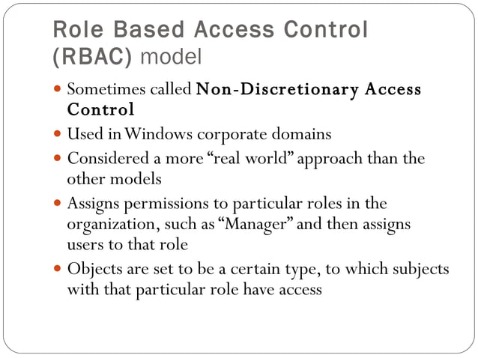

Slide 15
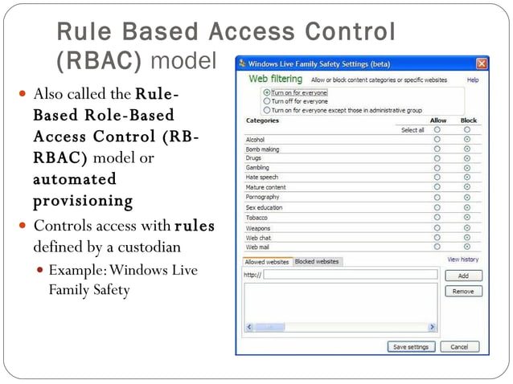
Notes:
Provision : access

Slide 16
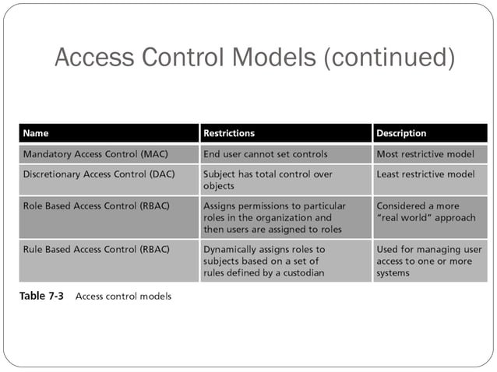

Slide 17
ATTRIBUTE-BASED ACCESS CONTROL
41
▶ Attribute-based access control (ABAC) is an access policy determined by the attributes of a subject and object, as well as environmental factors.
▶ In an ABAC-based system, the ability for a subject to access an object is based on one or more attributes about the subject (such as the subject’s position title, department, or project assignment), as well as attributes about the object itself (such as its name, project name, owner, or location).
▶ Further, environmental factors are used to determine whether access will be granted; example environmental factors include the location of the subject, the time of day, and other conditions.

Slide 18
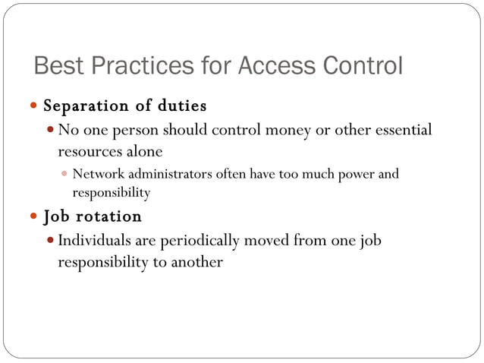

Slide 19
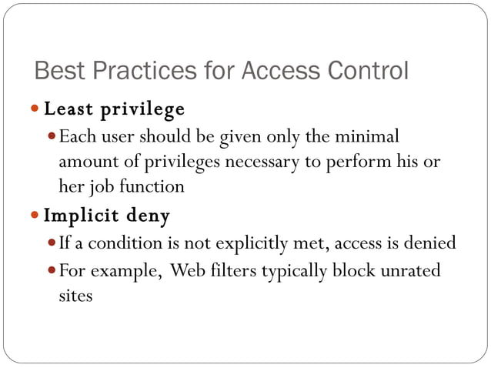
Notes:
an official classification due to its level of explicit material.
not highly regarded.

Slide 20
Implicit deny: In a file system, if no permission is set for User A to access File X, User A is denied access by default.
Explicit deny: A specific rule says, "Deny User A access to File X," even if User A has permissions to access other files.
Meaning: If no specific rule is set to allow access, it is automatically denied.
Meaning: A rule is explicitly created to deny access, even if other rules might allow it.

Slide 21
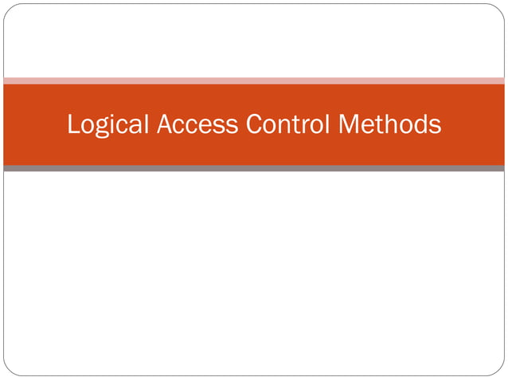

Slide 22
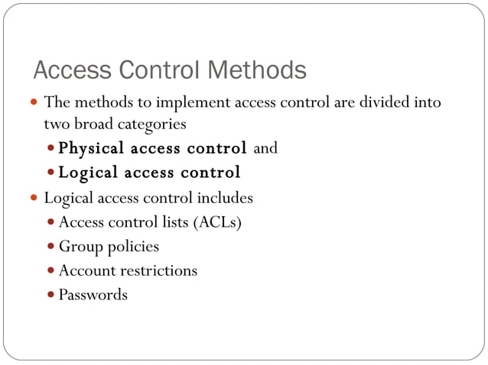

Slide 23
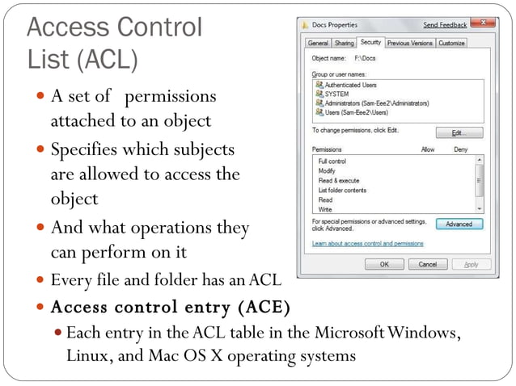
Access control list consists of set of permissions for a particular object and now it may have several access control entries defining access rights of different groups or individuals
Notes:
Access control entries (ACE) are entries in an access control list containing information describing the access rights related to a particular security identifier or user. Each access control entry contains an ID, which identifies the subject group or individual. An access control list may have several access control entries with each one defining the access rights of different groups or individuals.
Access control list consists of set of permissions for a particular object and now it may have several access control entries defining access rights of different groups or individuals

Slide 24
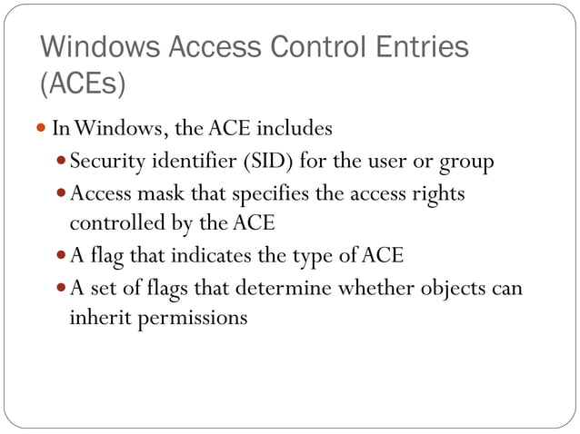

Slide 25
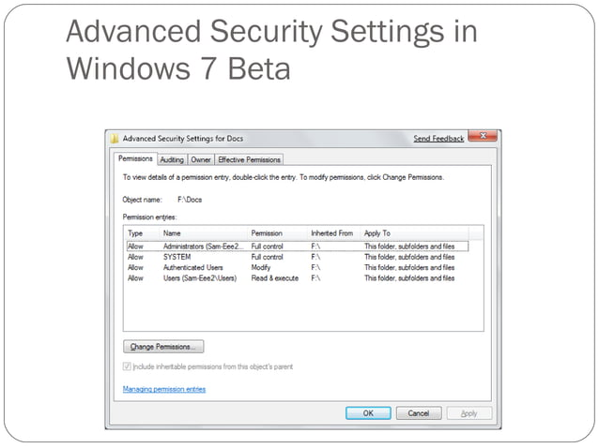

Slide 26
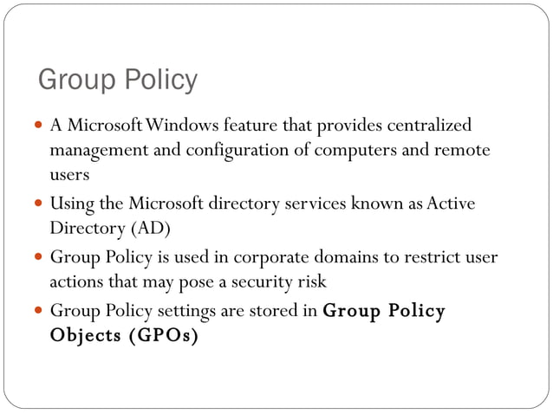

Slide 27
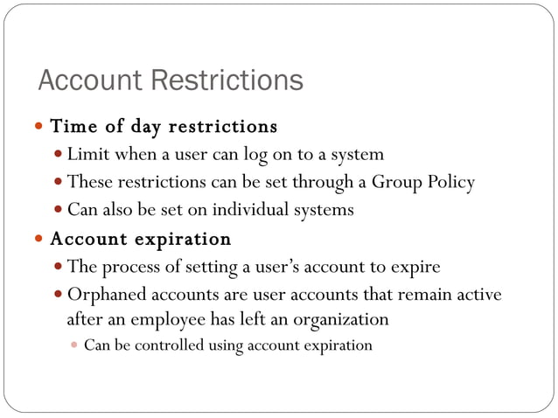

Slide 28
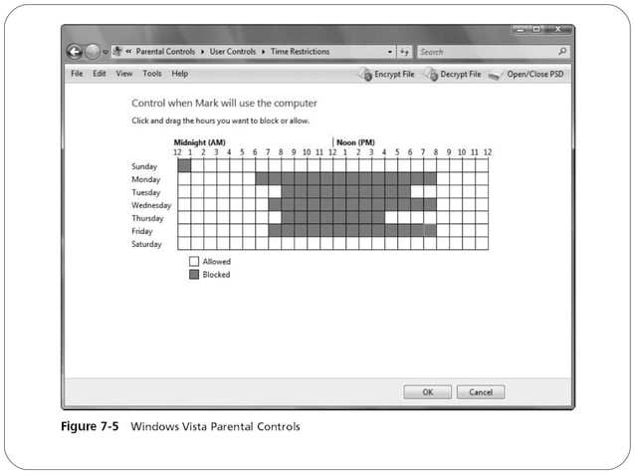

Slide 29
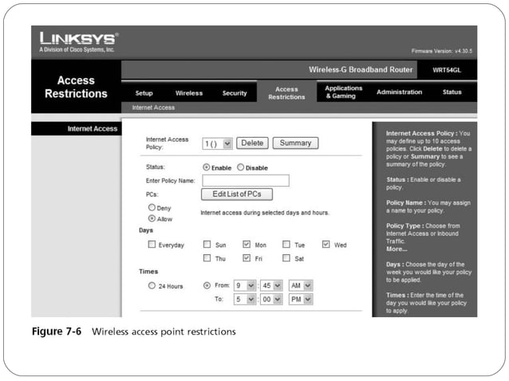

Slide 30
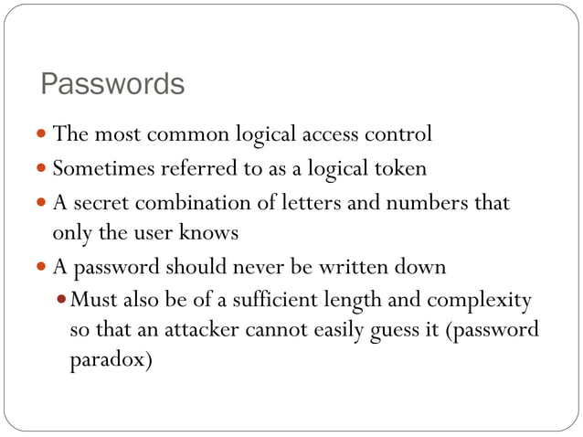

Slide 31
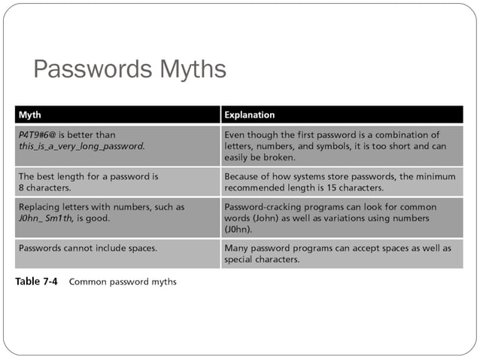

Slide 32
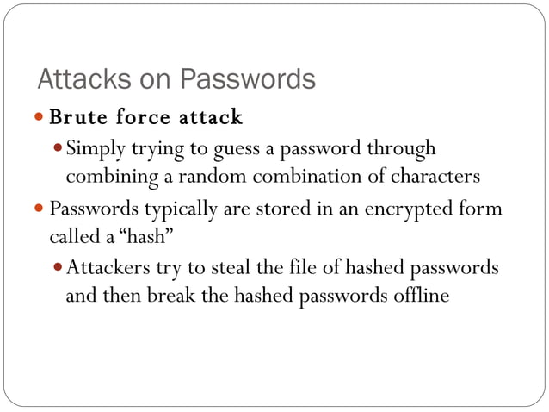

Slide 33
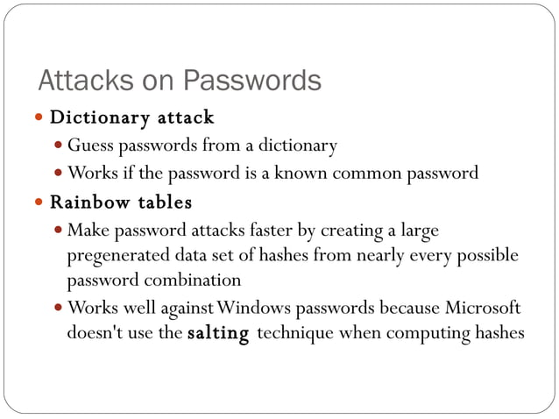

Slide 34
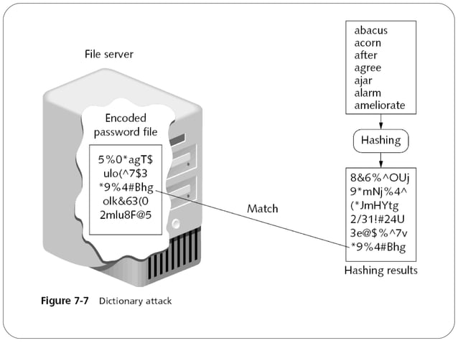

Slide 35
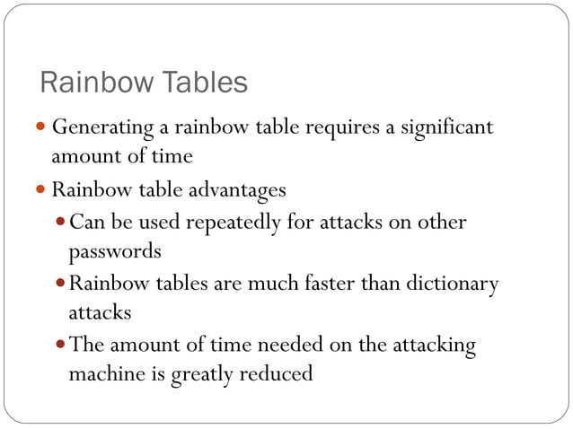

Slide 36
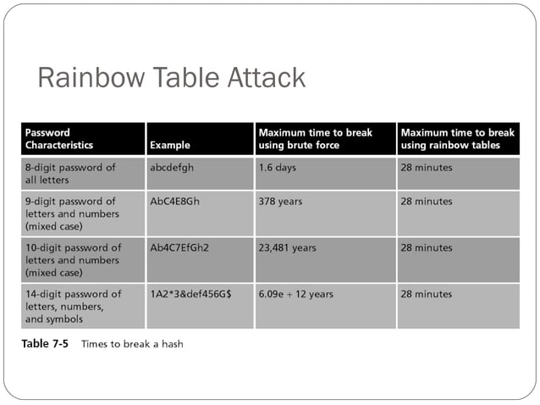

Slide 37
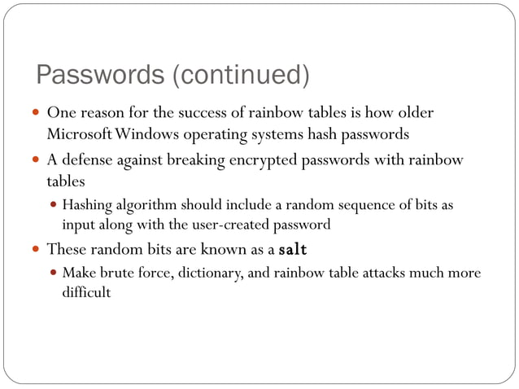

Slide 38
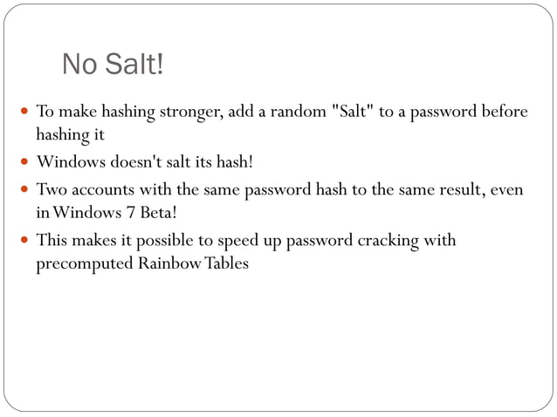

Slide 39
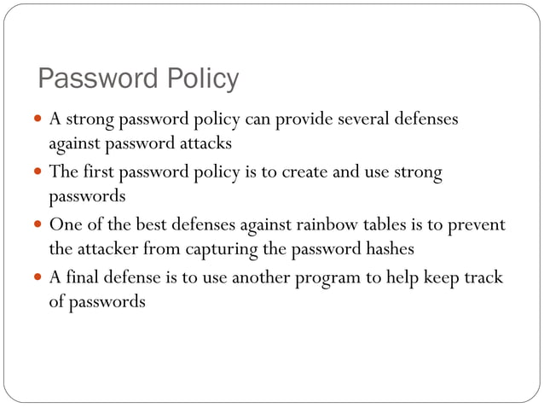

Slide 40
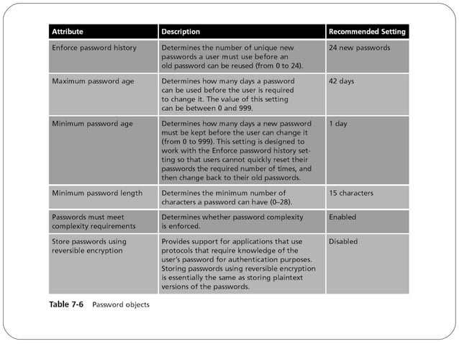

Slide 41
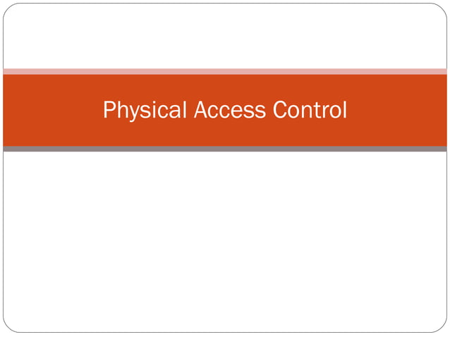

Slide 42
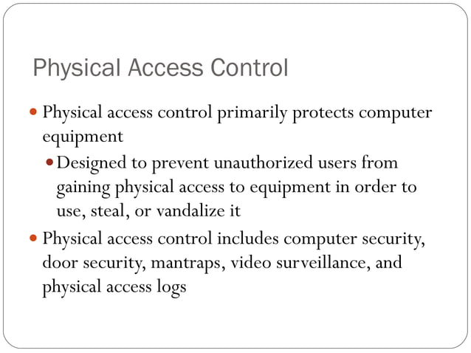

Slide 43
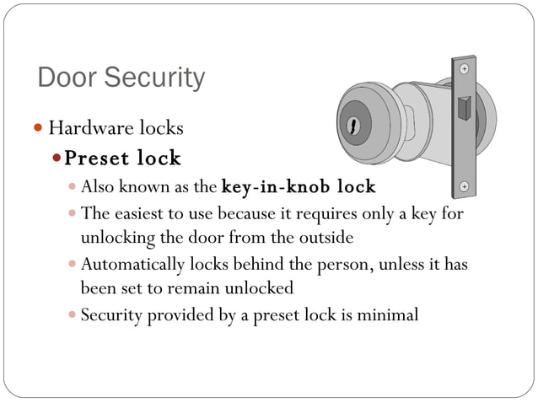

Slide 44
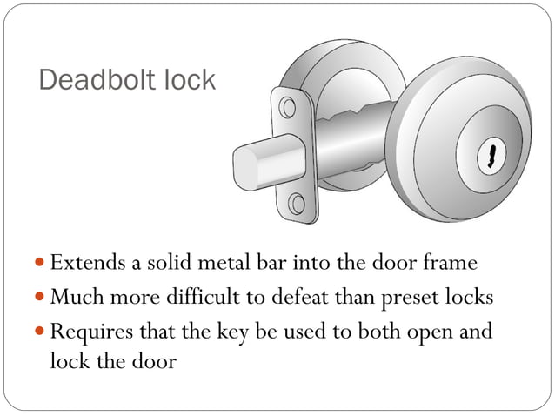

Slide 45
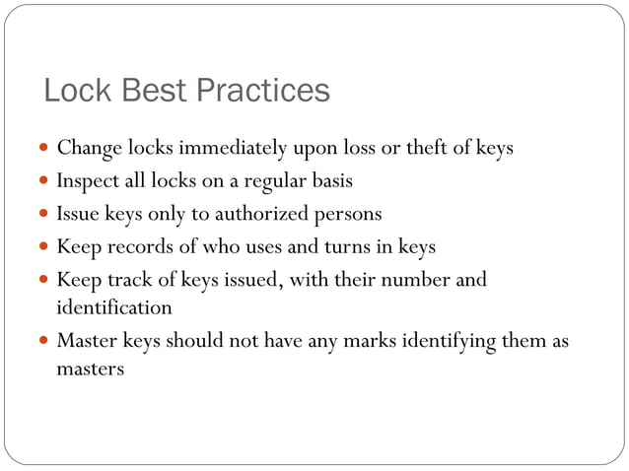

Slide 46
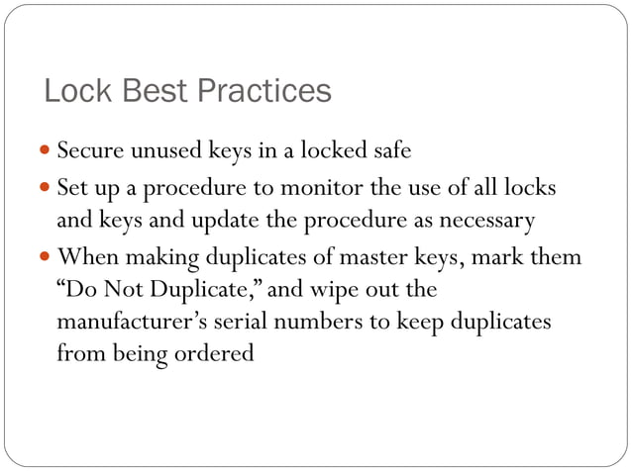
Notes:
Wipe out : vanish

Slide 47
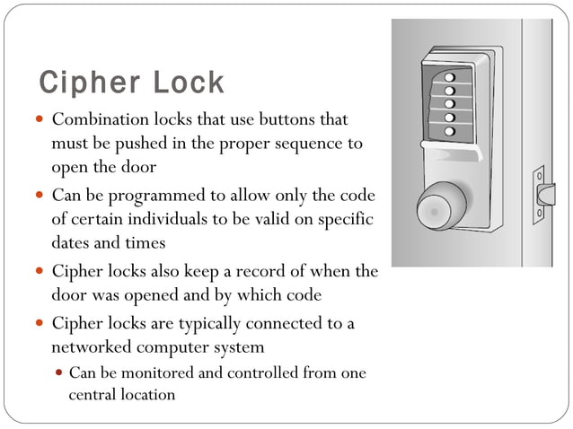

Slide 48
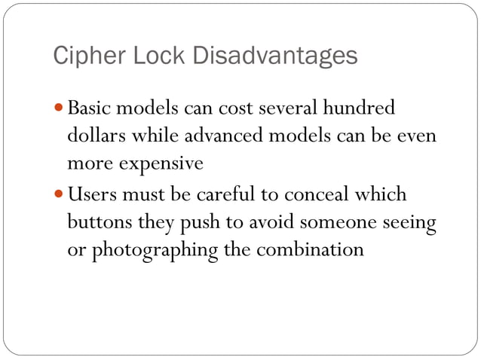

Slide 49
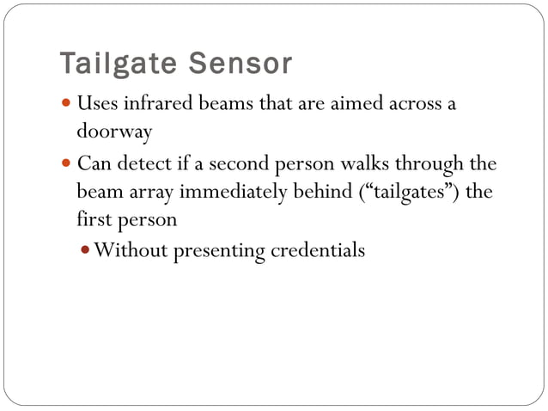

Slide 50
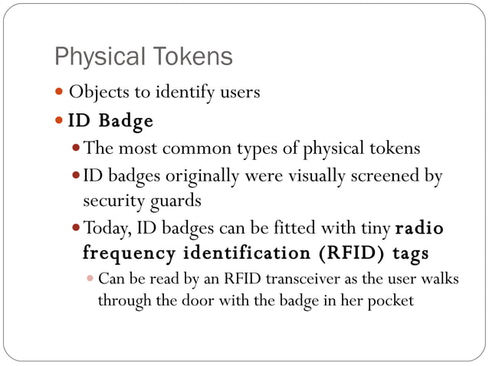

Slide 51
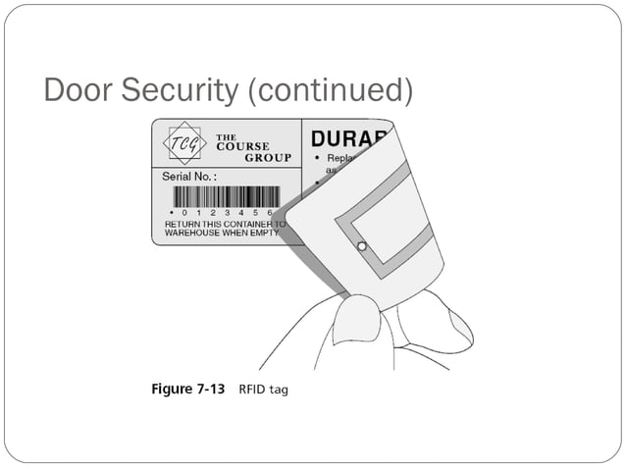

Slide 52
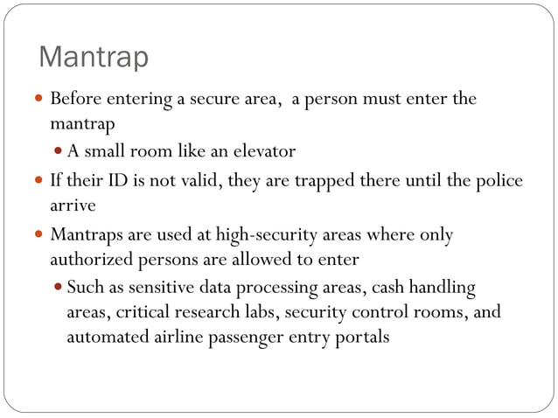

Slide 53
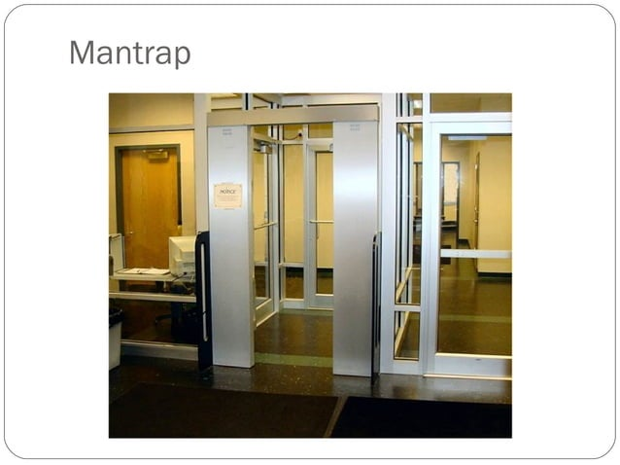

Slide 54
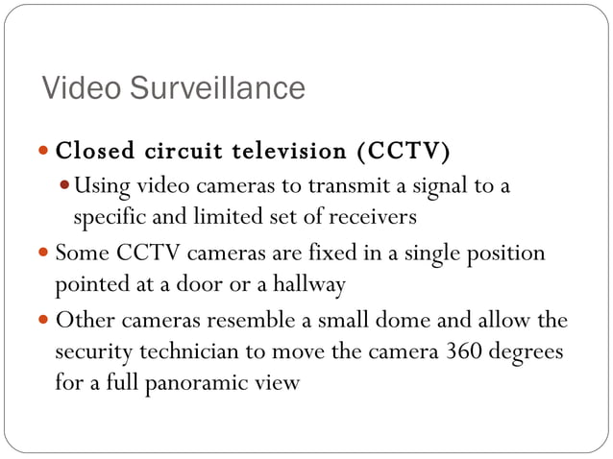
Notes:
Surveillance :close observation, especially of a suspected spy or criminal.

Slide 55


Slide 56
Identification
Method of establishing the subject's identity
  User, Program, Process
Use of username or other public information
Identification component requirements...
  Each value should be unique
  Follow a standard naming scheme
Non-descriptive of the user's position or tasks
  Must not be shared with users

Slide 57
Authentication
Method of proving the identity
How to prove an identity?
  Something you know
  Something you have
  Something you are
Use of passwords, token, or biometrics other private
information
What is two factor authentication?
Strong authentication

Slide 58
Something you know
Traditional authentication method
Passwords
Protected string of characters Most widely used
Types
  Cognitive passwords
  One time passwDrds (Dynamic passwords)
  Passphrase

Slide 59
Cognitive passwords
Fact or opinion based information
Created through several experience based questions
Easy to remember!
— A person will not forget his birthplace, favorite color, dog's
name, or the school he graduated from.

Slide 60
One time passwords
Only used once
Used in sensitive cases and places
Examples include
Prepaid cards
Token devices
    Token device generates the one-time password for the user to submit to an authentication server

Slide 61
Passphrase
Sequence of characters that is longer than a password -- Thus a phrase
— A passphrase is a sentence like string of words used for authentication that is longer than a traditional password, easy to remember and difficult to crack

Slide 62
Something you have
Requires possession of something such as a key, smart card, or some other device
Examples include...
Keys
  Documents Token devices
  Memory cards
  Smart cards

Slide 63

Token device
Software hardware hybrid object used to verify an identity in an authentication process
Token device, or password generator, is usually a handheld device that has an LCD display and possibly a keypad
— Token device is separate from the computer the user is
attempting to access
Provide two factor authentication
Limitations
— Human error Battery limitation

Slide 64
A device token is like a unique ID given to your phone by a service (e.g., Apple or Google) so it knows where to send notifications for apps.
A device token can be thought of as a key that allows a mobile banking app to securely communicate with the bank’s server, ensuring that only the authorized app on your phone can receive transaction alerts.

Slide 65
Something you are
Special case of something you have
Unique personal attribute is analyzed
Encompasses all biometric techniques
Fingerprints
Retina scan
Iris scan
Hand geometry
Facial scan
Notes:
cause to take place

Slide 66
Biometric System
A characteristic based system
  includes all the hardware, associated software and interconnecting infrastructure to enable the identification/authentication process
Uses individual's unique physical characteristics in order to identify and authenticate

Slide 67

Fingerprints
Every person's fingerprint is unique
Most affordable and convenient method of verifying a person's identity
The lines that create a fingerprint pattern are called ridges and the spaces between ridges are called valleys.

Slide 68

Retina Scan
Retinal scan technology maps the capillary pattern of the retina
— thin (1/50th inch) nerve on the back of the eye!
Accurate
Many people are hesitant to use the device

Slide 69

Iris Scan
Scans the iris or the colored portion of the eye
For authentication the subject looks at the video camera
from a distance of 3-10 inches
The entire enrollment process is less than 20 seconds, and subsequent identification takes 1-2 seconds.

Slide 70


Slide 71
Types of Access Controls
There are three types of Access Controls:
  Administrative controls
    Define roles, resppnsi bilities, policies, and administrative functions
to manage the control environment.
Technical controls
    Use hardware and software technology to implement access
control.
Physical controls
    Ensure safety and security of the physical environment.

Slide 72
Administrative Controls
Ensure that technical and physical controls are understood
and properly implemented
Policies and procedures
Security awareness training
  Classification and control
  Employment policies and practices (background checks, job
rotations, and separation of duties)
  Account administration Account, log monitoring
  Review of audit trails

Slide 73
Technical Controls
Examples of Technical Controls are:
Encryption
Biometrics
Smart cards
  Tokens
  Access control lists Violation reports
  Audit trails
  Network monitoring and intrusion detection

Slide 74
Physical Controls
Examples of Physical Controls are:
  HVAC ( heating, ventilation, and air conditioning)
  Fences, locked doors, and restricted areas
  Guards and dogs
  Motion detectors
  Video cameras
  Fire detectors
  Smoke detectors

Slide 75
Access Control Attacks
43
▶ Attackers commonly use several methods of attack against access control systems, including:
▶ Brute-force attack: The attacker attempts every possible combination of letters, numbers, and characters to crack a password, passphrase, or PIN.
▶ Dictionary attack: A dictionary attack is essentially a more focused type of brute force attack in which the attacker uses a predefined word list. You can find such word lists or dictionaries, including foreign language and special interest dictionaries, widely available on the Internet for use in password cracking utilities such as L0phtCrack and John the Ripper.
▶ Rainbow table: Here, an attacker steals the file or database containing hashed passwords from a target system, and then looks up the hashes in a large database called a rainbow table. This is essentially a list of all possible hashes and the original plaintext for each hash. If an organization has not “salted” its hashes, this type of attack is relatively easy to carry out.

Slide 76
Access Control Attacks
44
▶ Buffer or stack overflow: buffer overflows in certain systems or applications may enable an attacker to bypass authentication controls and gain unauthorized access to a system or directory. An overflow occurs when an application or protocol attempts to store more information than the allotted resources will allow. This causes previously entered data to become corrupted, the protocol or application to crash, or other unexpected or erratic behavior to occur
▶ Man-in-the-Middle attacks: Here, an attacker intercepts messages between two parties and forwards a modified version of the original message to the intended recipient.
▶ Packet (or password) sniffing: An attacker uses an application or device, known as a sniffer, to capture network packets and analyze their contents, such as usernames and passwords, and shared keys.

Slide 77
Access Control Attacks
45
▶ Session hijacking: Similar to a Man-in-the-Middle attack, except that the attacker impersonates the intended recipient, instead of modifying messages in transit.
▶ Social engineering: This low-tech method is one of the most effective and easily perpetrated forms of attack. Common techniques involve phishing, dumpster diving, shoulder surfing, raiding cubicles (looking for passwords on monitors, under keyboards, and under mouse pads). This latter bold technique can simply involve the attacker calling a user, pretending to be a system administrator and asking for the user’s password, or calling a help desk pretending to be a user and asking to have the password reset.

Slide 78






Access Provisioning Lifecycle
47
▶ Organizations must adopt formal policies and procedures to address account provisioning, review, and revocation.
▶ The phases in the IAM provisioning lifecycle are
▶ Role design, creation, and review. During development, customization, or configuration of a system, each of the user roles is designed. These designs are subjected to a review process to ensure they are appropriate.
▶ Access provisioning. When new or temporary employees, contractors, partners, auditors, and third parties require access to an organization’s systems and networks, the organization must have a formal methodology for requesting access. The steps in access provisioning are:
▶ Access request. A requestor, typically but not always the end user, makes a formal request to access specific data or a specific role in a system.
▶ Request review. The request is reviewed by a designated person or group for appropriateness. Sometimes the reviewer may ask questions of the requestor to better understand the reason for the request.
▶ Access approval. The request is approved by a designated person or group.
▶ Access provisioning. The requested and approved access is provisioned in the system.

Slide 79
Access Provisioning Lifecycle
48
▶ Account access review. User and system accounts, along with their assigned privileges, should be reviewed on a regular basis to ensure that they are still appropriate. For example, an employee may no longer require the same privilege levels due to rotation of duties or a transfer or promotion.
▶ Role review. Periodically, designated personnel examine the roles in a system to determine whether the access rights defined in each role are appropriate.
▶ Inactivity review. Periodically, designated personnel will examine a system to see whether users are accessing it. Users who have not accessed a system (or a role in the system) for a given period of time (for example, 90 days) may have their access revoked.
▶ Access termination. Finally, when access is no longer required, accounts must be promptly disabled and deprovisioned. Deprovisioning should be automated when possible and should include moving the disabled account to a protected organizational unit (in Active Directory) or other restricted group, as well as removing the disabled account from all group memberships.

Slide 80


Slide 81

Notes:
a barrier intended to prevent escape or intrusion or to mark a boundary. especially : such a barrier made of wire. :fencing
What is a Mantrap? A mantrap is an access control system that consists of a small space and two interlocking doors. One set of the doors must close before the other one can be opened so that an individual is briefly 'trapped' in the vestibule (entrance hall) before clearing the second door.
https://www.youtube.com/watch?v=1jGklBwZ7ZQ

Slide 82


Slide 83

Notes:
What is a XLSM file. XLSM(x-lsm) is the file extension that is assigned to spreadsheets created by Microsoft Excel 2007 and newer. They are saved using the Open XML standard. Just like older version of the Excel spreadsheet, XLSM files can contain tables and worksheets.
Salary Sheet is a ready-to-use template in Excel, Google Sheets, OpenOffice Calc, and Apple Numbers that helps you easily calculate the salary. It is a payroll .

Slide 84


Slide 85


Slide 86


Slide 87


Slide 88


Slide 89


Slide 90


Slide 91


Slide 92


Slide 93


Slide 94


Slide 95


Slide 96


Slide 97


Slide 98
Role-based access control
36
▶ Role-based access control assigns group membership according to organizational or functional roles.
▶ Individuals may belong to one or many groups
▶ a group may contain only a single individual
▶ Access rights and permissions for objects are assigned to groups, rather than (or in addition to) individuals.
▶ RBAC greatly simplifies the management of access rights and permissions, particularly in organizations that
▶ have large functional groups or departments,
▶ routinely rotate personnel through various positions or otherwise experience high turnover.

Slide 99
Rule-based access control
37
▶ Rule-based access control is one method of applying mandatory access control.
▶ Actually, all MAC-based systems implement a simple form of rule-based access control by matching:
▶ an object’s sensitivity label
▶ and a subject’s sensitivity label
▶ to determine whether the system should grant or deny access.
▶ You can apply additional rules by using rule-based access control to further define specific conditions for access to a requested object.
▶ Other types of rules to govern access include:
▶ Time of day
▶ Workstation or terminal in use
▶ User geographical location
▶ Contents of data being accessed

Slide 100
Mandatory access control
38
▶ A mandatory access control (MAC) is an access policy determined by the system, rather than by the owner.
▶ Organizations use MAC in multilevel systems that process highly sensitive data, such as classified government and military information.
▶ A multilevel system is a single computer system that handles multiple classification levels between subjects and objects.

Slide 101
Mandatory access control
39
▶ Two important concepts in MAC are:
▶ Sensitivity labels: In a MAC-based system, all subjects and objects must have assigned labels. A subject’s sensitivity label specifies its level of trust. An object’s sensitivity label specifies the level of trust required for access.
▶ In order to access a given object, the subject must have a sensitivity level equal to or higher than the requested object.
▶ For example, a user (subject) with a Top Secret clearance (sensitivity label) is permitted to access a file (object) that has a Secret classification level (sensitivity label) because his or her clearance level exceeds the minimum required for access.
▶ Data import and export: Controlling the import of information from other systems and the export to other systems (including printers) is a critical function of MAC-based systems,
▶ must ensure that the system properly maintains and implements sensitivity labels so that sensitive information is appropriately protected at all times.

Slide 102
Discretionary access control
40
▶ A discretionary access control (DAC) is an access policy determined by the owner of a file (or other resource).
▶ The owner decides who’s allowed access to the file and what privileges they have.
▶ In DAC, the owner determines the access policy.
▶ Two important concepts in DAC are:
▶ File and data ownership: Because the owner of the resource determines the access policy, every object in a system must have an owner. Theoretically, an object without an owner is left unprotected, or without a user who can determine who or what can access it.
▶ Access rights and permissions: The controls that an owner can assign to individual users or groups for specific resources. Various systems (Windows based or UNIX-based) define different sets of permissions that are essentially variations or extensions of three basic types of access:
▶ Read, Write, Execute
▶ Access control lists (ACLs) provide a flexible method for applying discretionary access controls.

Slide 103
Risk Adaptive (Adaptable) Access Control
In RAdAC, access privileges are granted based on a combination of a user’s identity, mission need, and the level of security risk that exists between the system being accessed and a user. RAdAC will use security metrics, such as the strength of the authentication method, the level of assurance of the session connection between the system and a user, and the physical location of a user,
Kerberos, a network protocol that is used in Microsoft networks for the encryption of passwords before they are submitted to the system for authentication.
Layer 2 and Layer 3 controls:
Layer 2 is associated with communication inside a network, while Layer 3 is associated with communication from one network to another network.
Layer 2 is the layer associated with MAC (Media Access Control) addresses, the addresses that are assigned to network interface cards.
Layer 3 Note the method of configuring access control lists on routers to allow or block traffic based on IP address or protocol being used.
Route maps are another method used on routers to send traffic to specific addresses, usually gateways to internal networks or resources. Route maps can also drop traffic that does not meet the criteria for being forwarded.
Notes:
In case you are not aware of it, the first three pairs, reading from left to right, stand for the manufacturer of the NIC. The last three pairs are the serial number of the NIC. Each MAC address is meant to be unique. The text tells us that switches take note of two things when they receive messages. The port on which the message is received is stored in an address table, along with the MAC address of the sending device. In this way, the switch learns which port to associate with particular devices. The switch uses this table as a reference when deciding what port to use for any message it needs to forward. Managed switches can be programmed to allow access to certain ports/paths through a network by filtering MAC addresses. The text warns us that a hacker may spoof (impersonate) a MAC address on the approved list in order to gain access to the protected network segment.

Slide 104
Sandboxing
A sandbox is an isolated testing environment that enables users to run programs or open files without affecting the application, system or platform on which they run.
Software developers use sandboxes to test new programming code. Cybersecurity professionals use sandboxes to test potentially malicious software. Without sandboxing, software or applications could have potentially unlimited access to all the user data and system resources on a network.
Sandboxing protects an organization's critical infrastructure from suspicious code because it runs in a separate system. It also allows IT to test malicious code in an isolated testing environment to understand how it works as well as more rapidly detect similar malware attacks.
Using a sandbox to test software changes before they go live means there are fewer problems during and after testing because the testing environment is totally separate from the production environment.
In general, a sandbox is used to test suspicious programs that may contain viruses or other malware, without allowing the software to harm the host devices.
Sandboxing also complements other security programs, including behavior monitoring and virus programs. It offers added protection against certain strains of malware that an antivirus program may not detect.

Slide 105
Some specific examples of using a sandbox include:
Web browsers. A trusted web browser can be run inside a sandbox. Then if a website exploits a vulnerability in that web browser, the damage is limited to the sandbox and minimized.
Security research. Information security professionals use sandboxes for research or to detect malicious code. For instance, a security tool could visit websites to monitor what files are ultimately changed.
Virtualization. A VM is basically a type of sandbox. This approach uses a VM-based sandbox to contain and examine suspicious programs.
Sandbox applications include:
Browser plug-in content often depended on using a sandbox to screen content loaded by browser plug-ins, Adobe Flash.
PDFs and other documents may include executable code, so Adobe Reader Protected Mode runs PDF files in a sandbox.
Mobile apps are generally executed by mobile platforms in sandboxes.

Slide 106
Network Access Control
Network access control is defined as an enterprise security solution used to assess, manage, enforce, and optimize security and authentication policies through different measures like endpoint security, user access authentication, and network security policies.
Network access control aims to build a security fortress through which unauthorized users, illegitimate device activity, and network-based threats cannot penetrate.
Several drivers are encouraging the adoption of network access control strategies and solutions:
Strengthening security after an audit
Coping with the rise in third-party vulnerabilities
Integrating with other security essentials
ZTNA is a type of network access control policy
Notes:
Fortess: hold, keep

Slide 107

Key Components of Network Access Control

Slide 108
IEEE 802.11 wireless LANs
IEEE 802.11 defines standards for wireless local area networks (WLANs), commonly known as Wi-Fi, enabling wireless communication between devices over short distances.
An example of IEEE 802.11 is Wi-Fi 6 (802.11ax), which provides faster speeds, better performance in dense environments, and improved efficiency for wireless networks like those used in homes, offices, and public hotspots.
In a home setting, IEEE 802.11 standards are used for Wi-Fi routers that connect smartphones, laptops, smart TVs, and other devices to the internet wirelessly, allowing seamless internet access throughout the house.
IEEE 802.11 wireless LANs use a media access control protocol called Carrier Sense Multiple Access with Collision Avoidance (CSMA/CA).
WiFi systems are the half duplex shared media configurations, where all stations transmit and receive on the same radio channel. The fundamental problem of a radio system is that a station cannot hear while it is sending, and hence it is impossible to detect a collision. Because of this, the developers of the 802.11 specifications came up with a collision avoidance mechanism called the Distributed Control Function (DCF).
According to DCF, a WiFi station will transmit only when the channel is clear. All transmissions are acknowledged, so if a station does not receive an acknowledgement, it assumes a collision occurred and retries after a random waiting interval.The incidence of collisions will increase as the traffic increases or in situations where mobile stations cannot hear each other.

Slide 109
Centralized access control: A single authority (e.g., Active Directory) manages permissions for all users and resources in one place. Example: A company's IT department controls employee access to all systems from a central server.
Decentralized access control: Access control is managed locally by each department or system. Example: Each department in an organization manages its own user permissions for specific systems independently.

Slide 110
Centralized vs. Decentralized Access Control
Centralized access control is an access control approach in which a single common entity— such as an individual, department, or device—decides who can get into systems and networks. The access controls are managed centrally rather than at the local level. Security Assertion Markup Language (SAML) is an open standard used for exchanging both authentication and authorization data. SAML is based on XML and was designed to support access control needs for distributed systems. SAML is often used in web application access control. Systems that use SAML do depend on a central trusted authority to issue security tokens.
Another access control approach is to handle access control decisions and administration locally. This approach is called decentralized access control. That means access control is in the hands of the people, such as department managers who are closest to the system users. Access requests are not processed by one centralized entity.
The two most common examples of decentralized access control are the Password Authentication Protocol (PAP), which uses cleartext usernames and passwords, and the Challenge-Handshake Authentication Protocol (CHAP). CHAP is more secure than PAP since it hashes the password with a one-time challenge number to defeat eavesdropping-based replay attacks.

